Slide 1
Comparative Intelligence & Ethics in ML: Classical vs Deep Recommenders on MovieLens 100K
Rating prediction + Top-10 ranking on 100,000 real movie ratings
Classical (ItemKNN / Gradient Boosting) vs Deep (NeuMF): RMSE 0.9224 / 0.9273 vs 0.9150
Every figure, metric and conclusion generated from code — fully reproducible
Notes:
Introduce yourself. One sentence: we compare a classical and a deep recommender end-to-end — accuracy, explainability, bias, ethics, and deployment — with every claim generated from the data.

Slide 2
Problem & Objectives
Task: predict ratings (1–5) and rank unseen movies for 943 users
Compare one classical ML and one PyTorch deep model — same data, same protocol
Beyond accuracy, measure what deployment actually requires:
Explainability — can we tell a user WHY?
Bias — cold-start, activity, popularity, demographic subgroups
Diversity — do recommendations concentrate on blockbusters?
Ethics & deployment — privacy, fairness, trust, production design
Notes:
Frame the comparison honestly: not just 'which is more accurate' but which is explainable, fair, and deployable. These are the assignment's own dimensions and they genuinely trade off — that's the story arc.

Slide 3
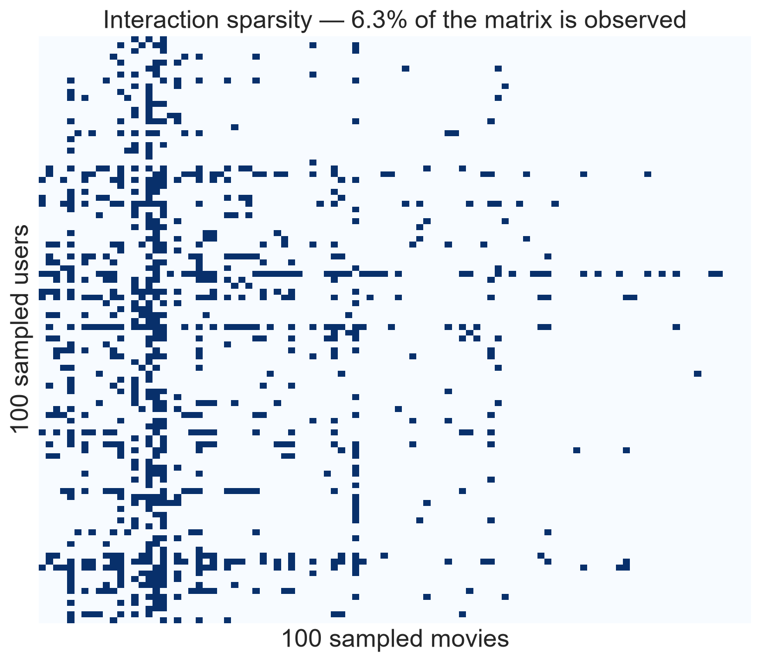
Dataset: MovieLens 100K (verified)
100,000 ratings · 943 users · 1,682 movies (1997–98)
Matrix density 6.3% — sparsity is the core challenge
Demographics: 71% male, median age 31
Top 10% of movies hold 42.7% of ratings
530 movies (31.5%) have < 10 ratings
Canonical 5-fold splits (u1–u5) — literature-comparable
Notes:
All facts computed by verify_dataset.py — 20/20 files, 8/8 integrity checks. Call out the two facts that drive the whole project: 6.3% density and the skew (71% male, long-tail catalogue).

Slide 4
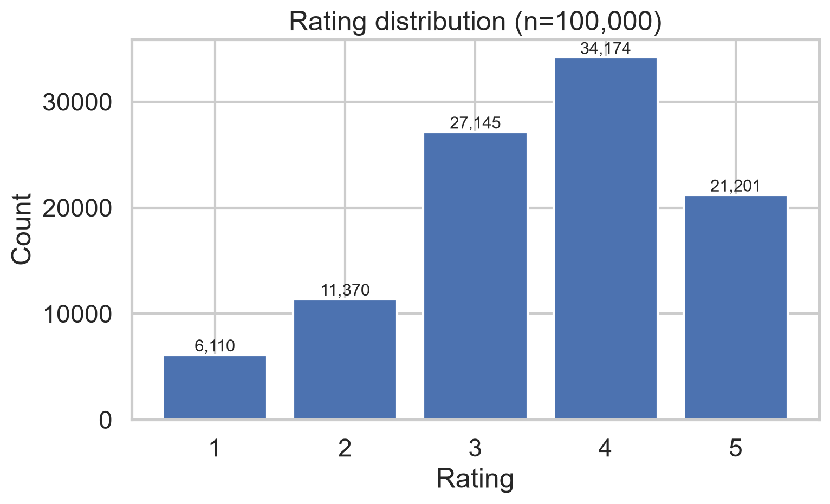
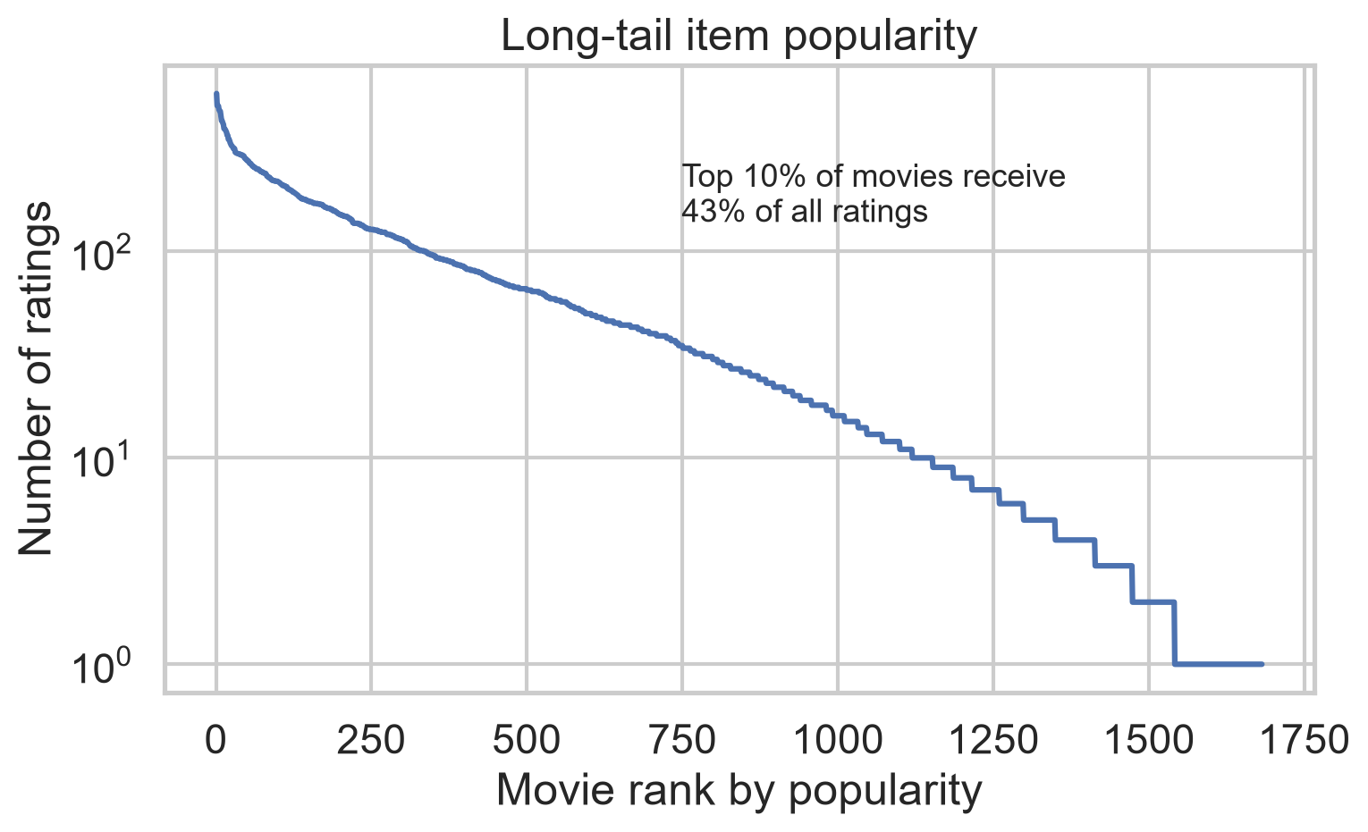
Exploratory Analysis
Notes:
Left: ratings skew positive (mean 3.53) — naive baselines are already decent. Right: the long tail — the fairness/diversity problem in one picture.

Slide 5
Methodology: Leakage-Free Pipeline, Canonical 5-Fold CV
Validation: canonical u1–u5 folds — every rating tested exactly once
Why not Stratified K-Fold? Stratification protects class balance in classification;
for recommenders the risks are per-user coverage & leakage — the canonical folds solve both
All statistic features fitted on train only; unseen users/items → training priors
Metrics: RMSE, MAE + NDCG@10, Precision@10, Recall@10 (relevance = rating ≥ 4)
Determinism: SEED=42 across numpy/torch/sklearn; results are exactly reproducible
Notes:
Two defensible choices: (1) canonical GroupLens folds instead of random stratified K-fold — disjoint, complete, per-user coverage, comparable to 25 years of literature; (2) FeatureBuilder fits statistics on the training fold ONLY — no leakage by construction.

Slide 6
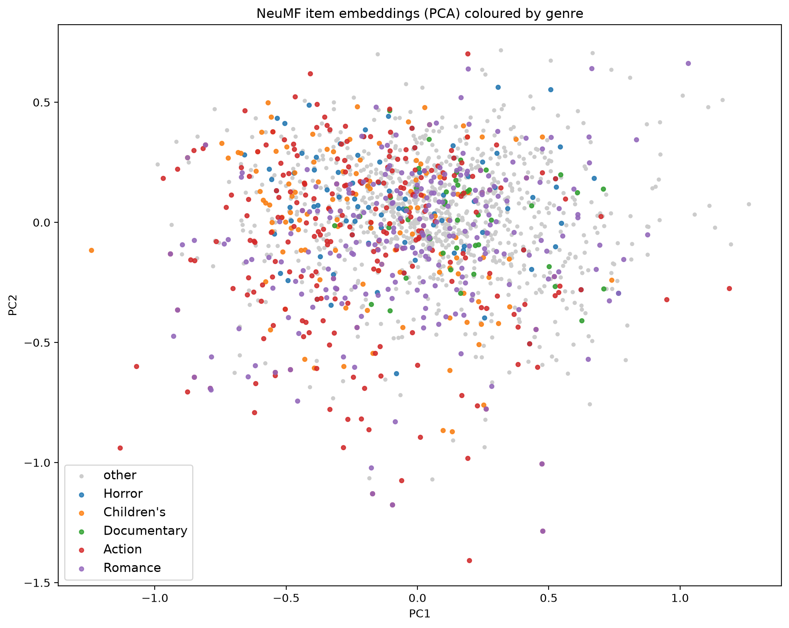
Two Model Families
Classical ladder (Scikit-learn):
Global/User/Item means → damped bias model
ItemKNN: shrunk cosine, mean-centred
HistGradientBoosting: 69 features
25-candidate seeded random search
Deep (PyTorch): NeuMF
GMF ⊕ MLP (64→32→16) + bias terms
Adam, MSE, early stopping (~12 epochs)
Notes:
Model ladder: each step must beat the last to justify its complexity. Classical: ItemKNN (neighbourhood CF) and gradient boosting on 69 engineered features — chosen for native SHAP explainability. Deep: NeuMF — GMF learns linear factor interactions, MLP learns non-linear ones, plus bias terms so the net only models residual structure.

Slide 7
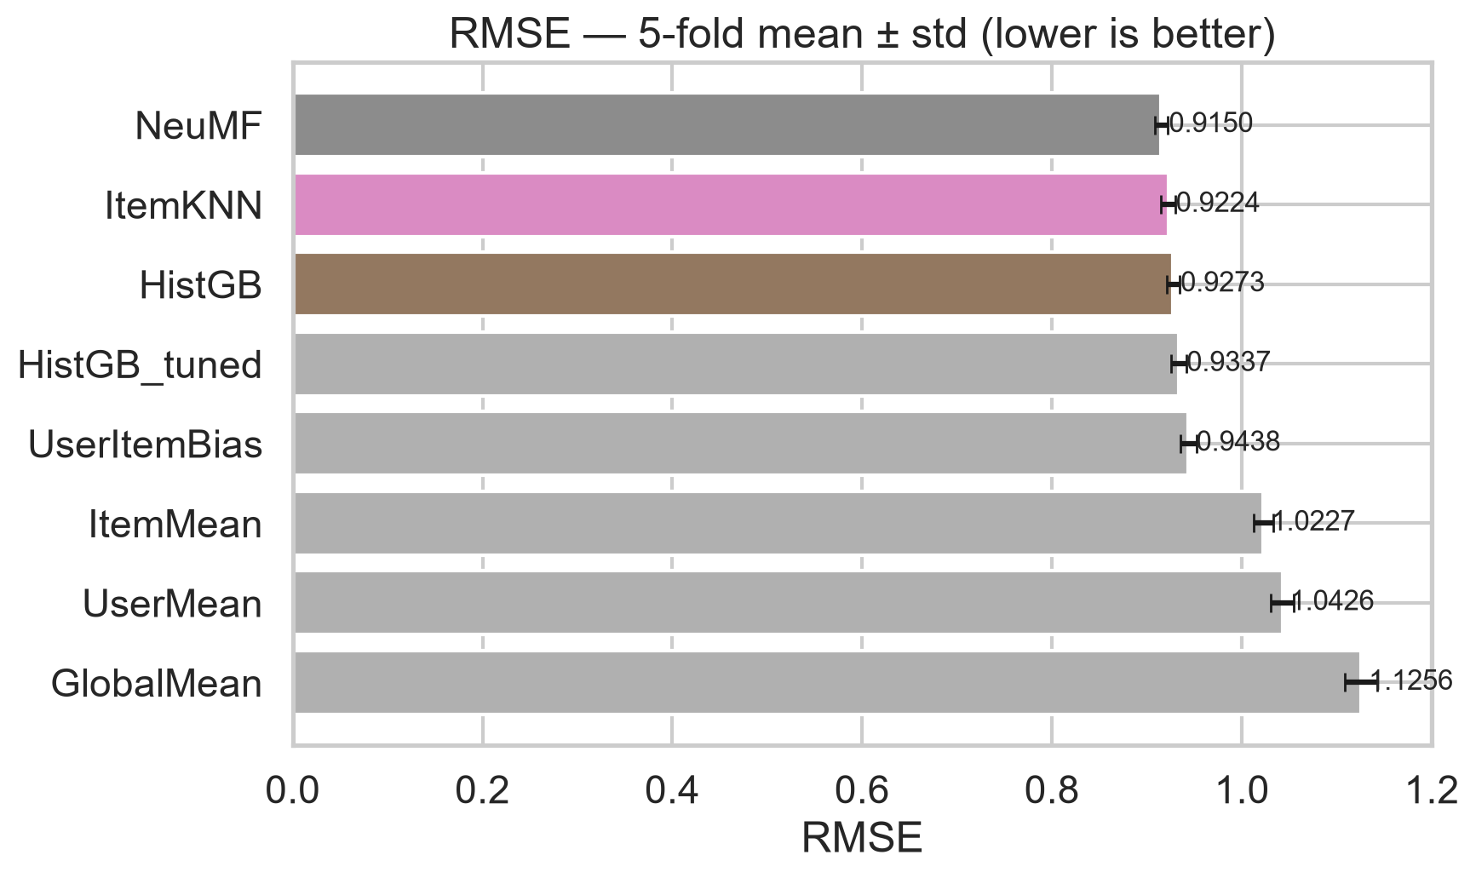
Results: NeuMF Wins Accuracy — Narrowly
model | RMSE | MAE | NDCG@10
NeuMF | 0.9150 | 0.7179 | 0.8512
ItemKNN | 0.9224 | 0.7245 | 0.8534
HistGB | 0.9273 | 0.7293 | 0.8390
HistGB_tuned | 0.9337 | 0.7306 | 0.8324
UserItemBias | 0.9438 | 0.7475 | 0.8345
ItemMean | 1.0227 | 0.8176 | 0.8344
UserMean | 1.0426 | 0.8378 | 0.7366
GlobalMean | 1.1256 | 0.9447 | 0.7366
Notes:
Read the table: NeuMF 0.9150 vs ItemKNN 0.9224 vs HistGB 0.9273 (5-fold means). Honest finding: the tuned HGB config won validation but lost on the canonical folds — validation-protocol mismatch, kept the conservative config. Std devs ~0.007 — differences are small but consistent across folds.

Slide 8
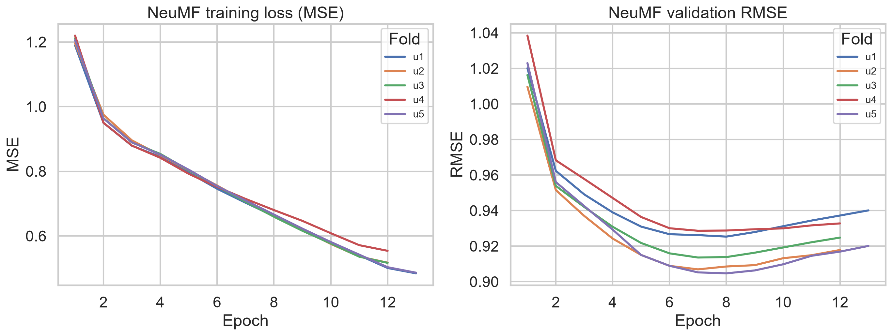
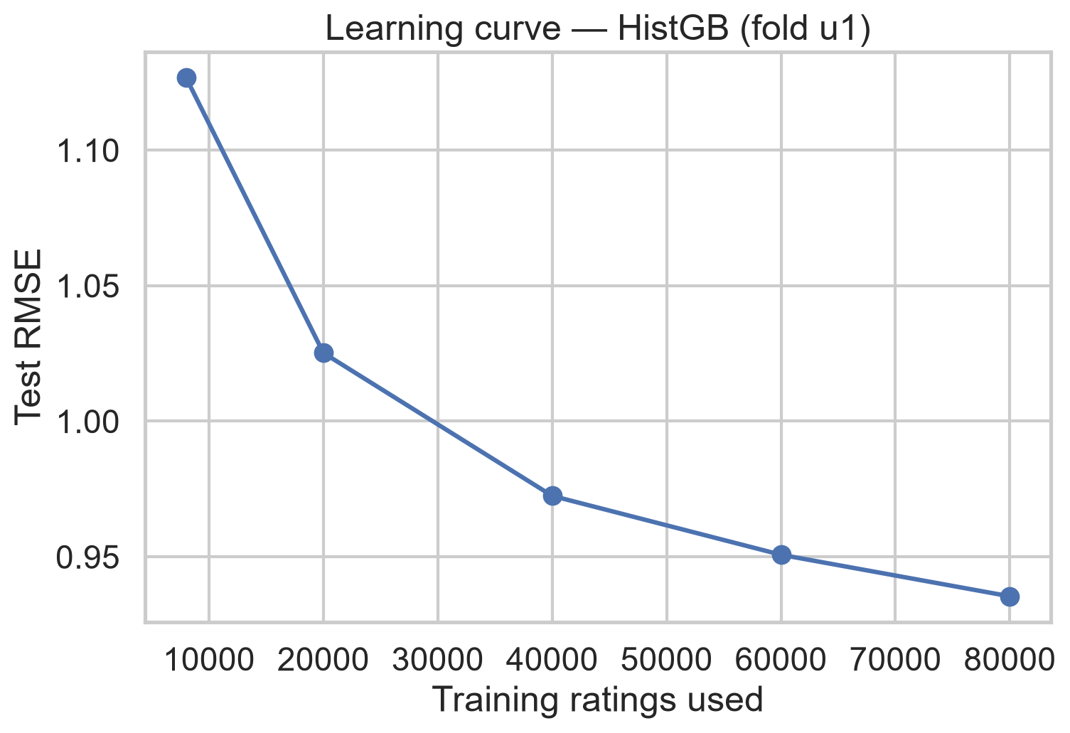
Training Dynamics & Data Efficiency
Notes:
Left: NeuMF converges in ~12 epochs, early stopping prevents overfitting; validation RMSE flattens while train keeps dropping. Right: the learning curve is still steep at 80K ratings — deep models remain data-hungry; at this scale classical CF stays competitive. This explains WHY the gap is narrow.

Slide 9
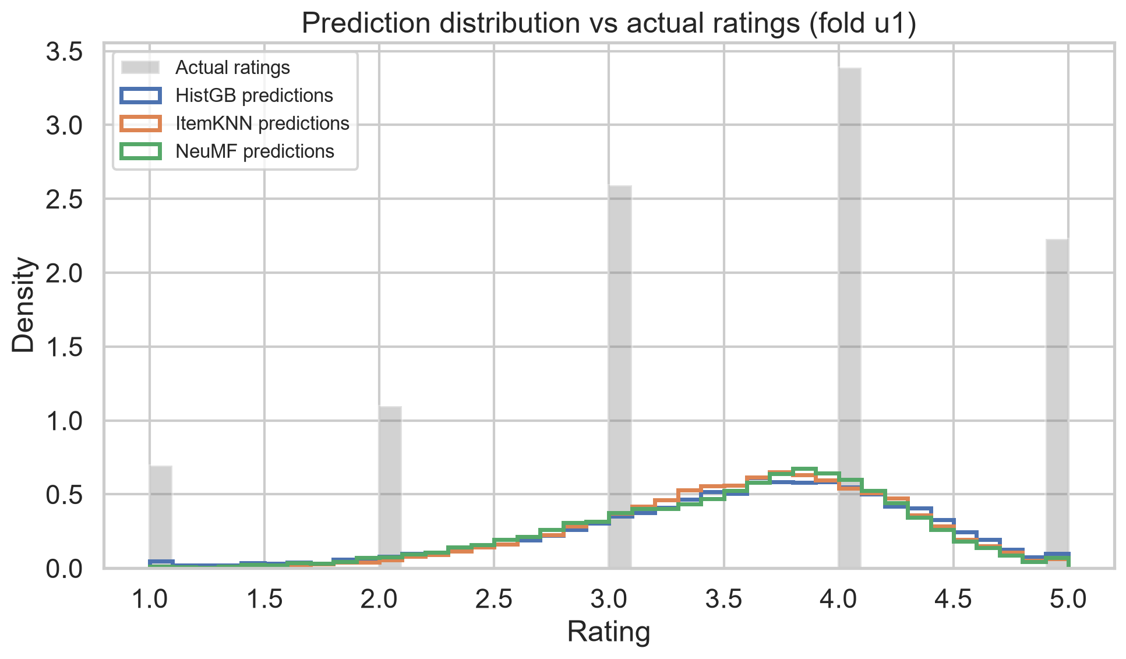
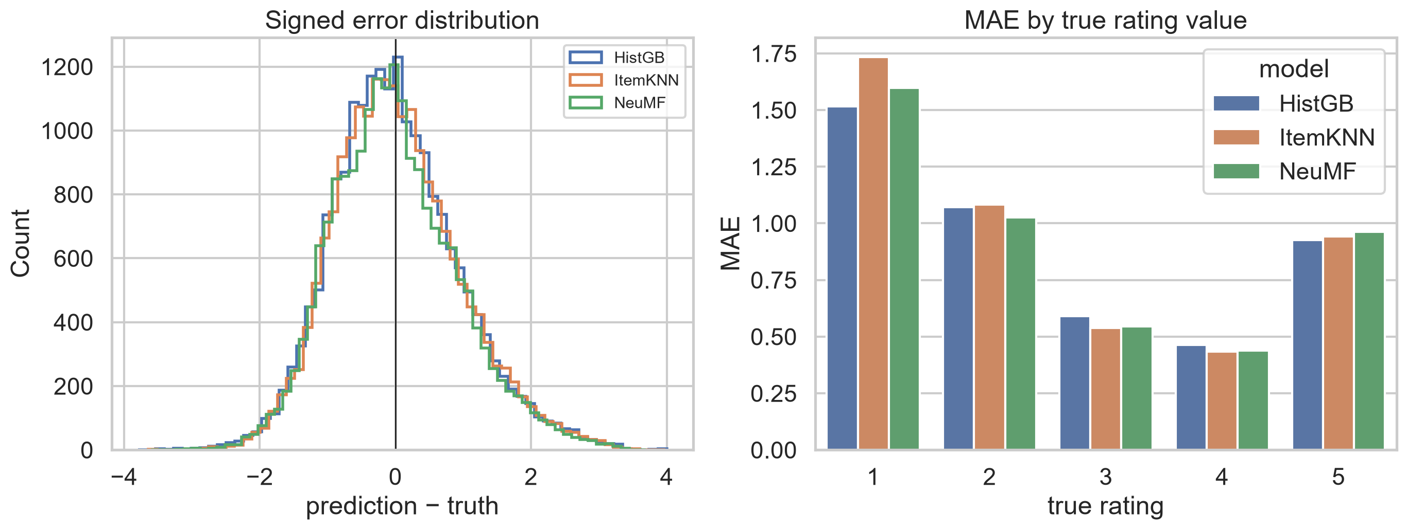
Where the Models Are Wrong
Notes:
Both models compress toward the mean: they almost never predict 1 or 5. MAE at true rating 1 is ~3x MAE at rating 4 — extreme opinions are the hardest to predict. The failure case in the SHAP section shows one concrete 4.87-predicted / 1.0-actual example.

Slide 10
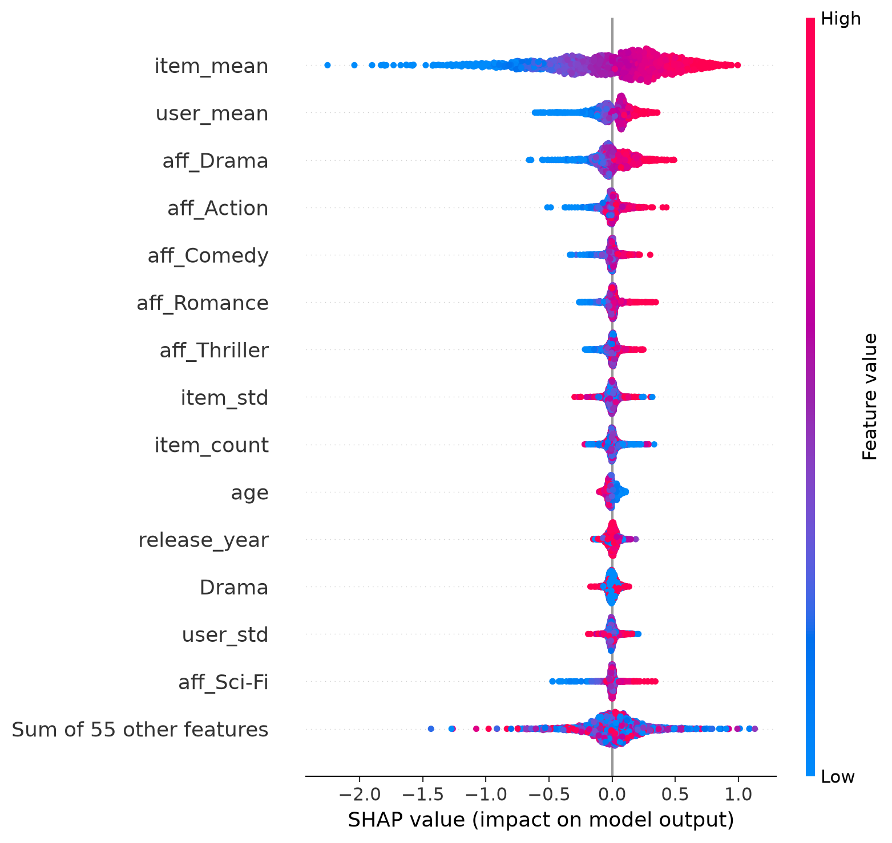
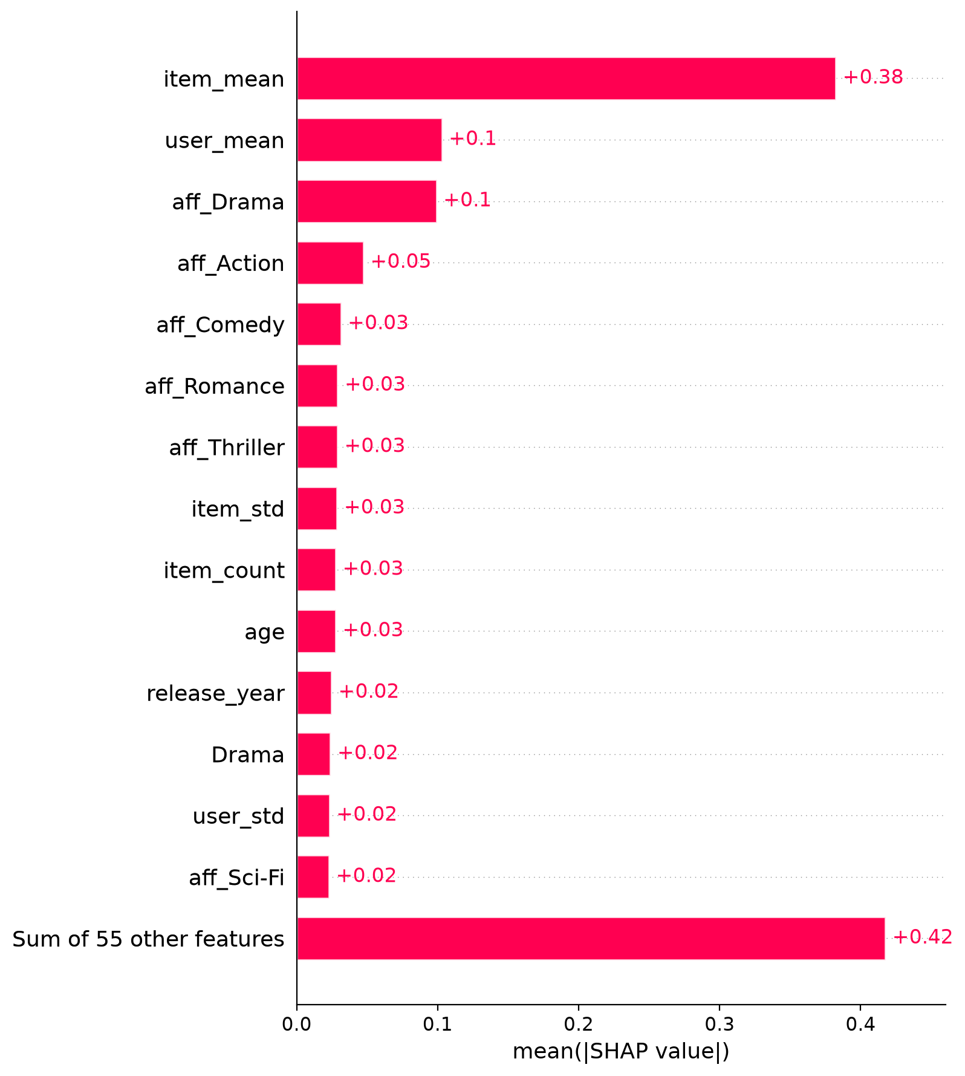
Explainability I — SHAP on the Classical Model
Notes:
Global story: item quality (item_mean, mean|SHAP| 0.382) dominates, then the user's own scale (0.103) and genre affinities (0.099). Demographics rank 10th or lower — the model personalises on taste, not on who you are. That's a measured transparency claim.

Slide 11
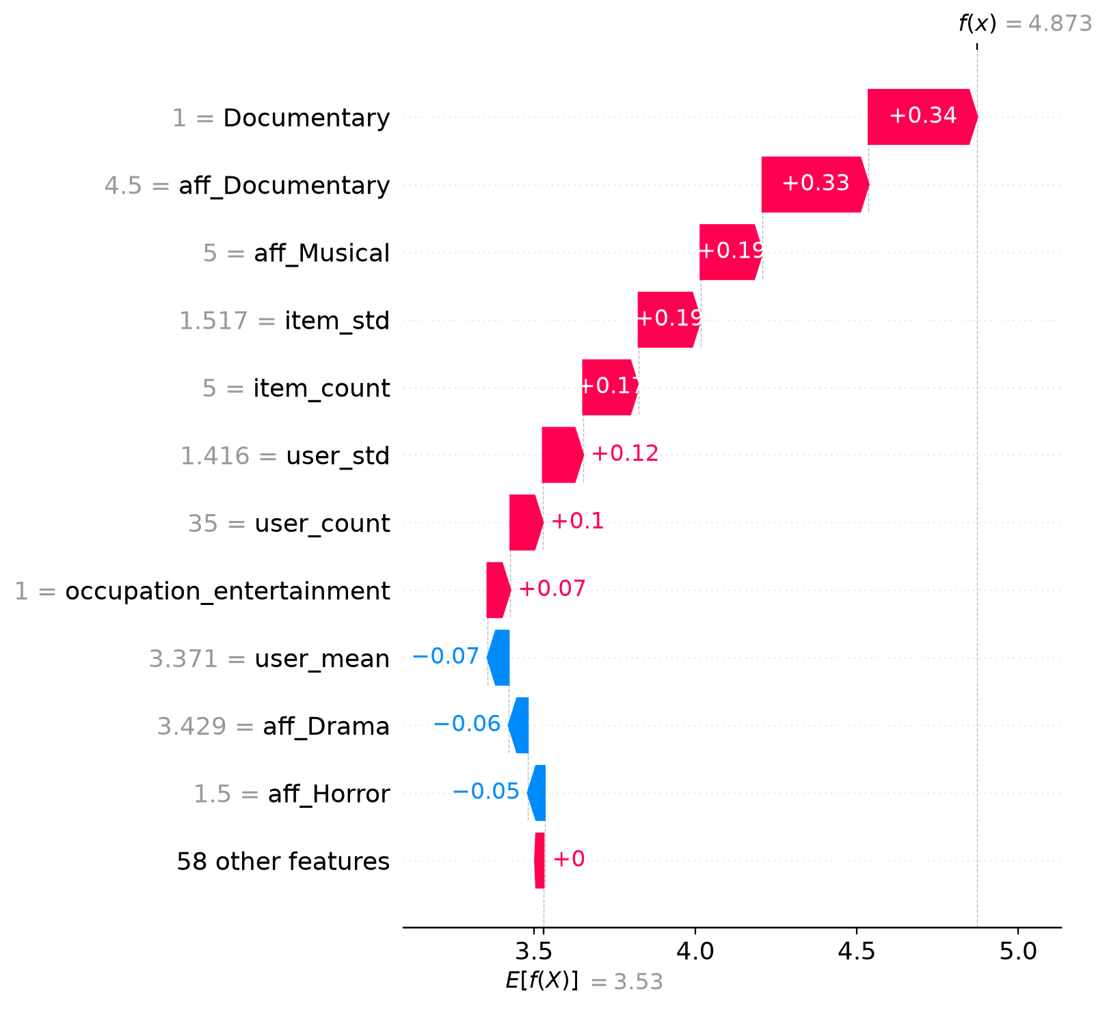
Explainability II — Individual Decisions & the Deep Model
Notes:
Left: a failure case decomposed — the model trusted item quality and genre affinity for a film this user hated; recommenders cannot see context. Right: NeuMF has no tabular features, so SHAP is inapplicable (justified in report) — instead, centred embedding analysis shows learned genre structure without genre labels.

Slide 12
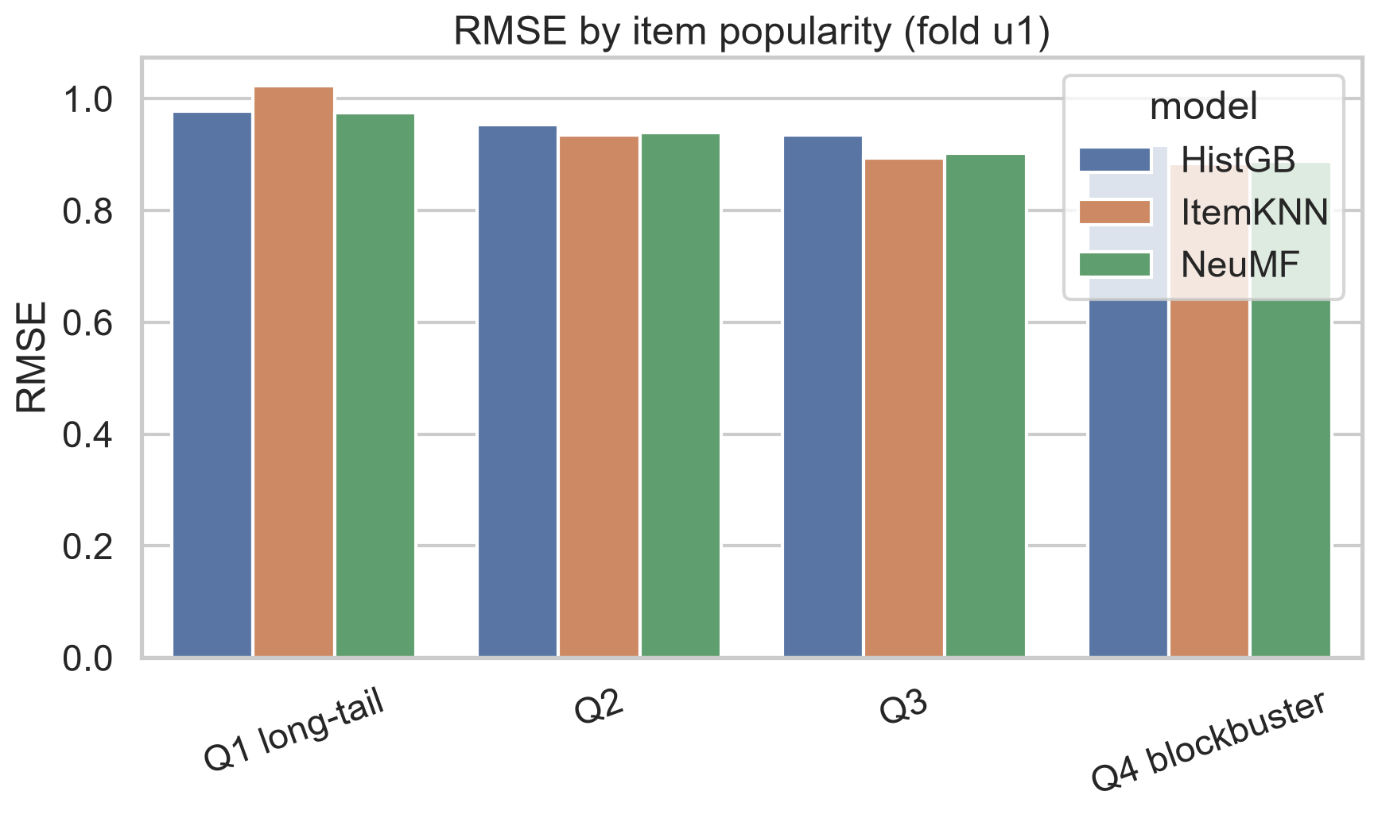
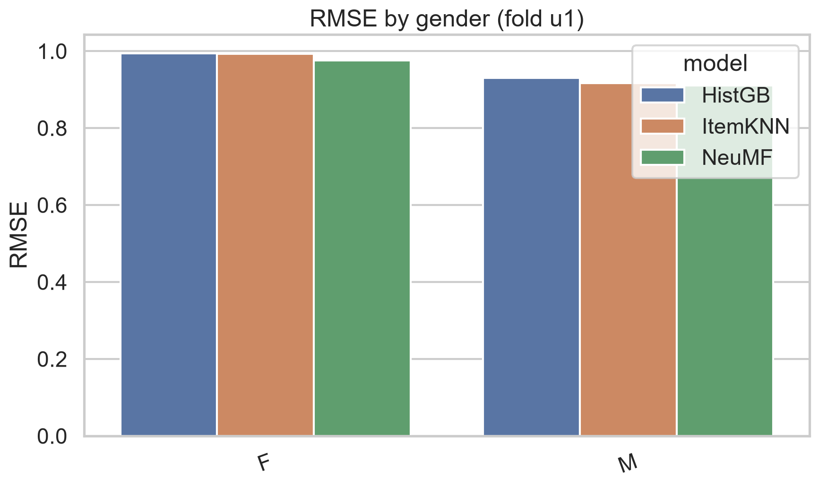
Bias I — Who Is Served Well?
group | HistGB | ItemKNN | NeuMF
F | 0.9939 | 0.9931 | 0.9761
M | 0.9300 | 0.9163 | 0.9104
Notes:
The gender gap is consistent across all three models: female users' ratings are predicted ~0.06 RMSE worse (NeuMF: F 0.976 vs M 0.910) — they are 29% of users and 25.7% of ratings, so the models optimise for majority taste. Same pattern for young users and long-tail items.

Slide 13
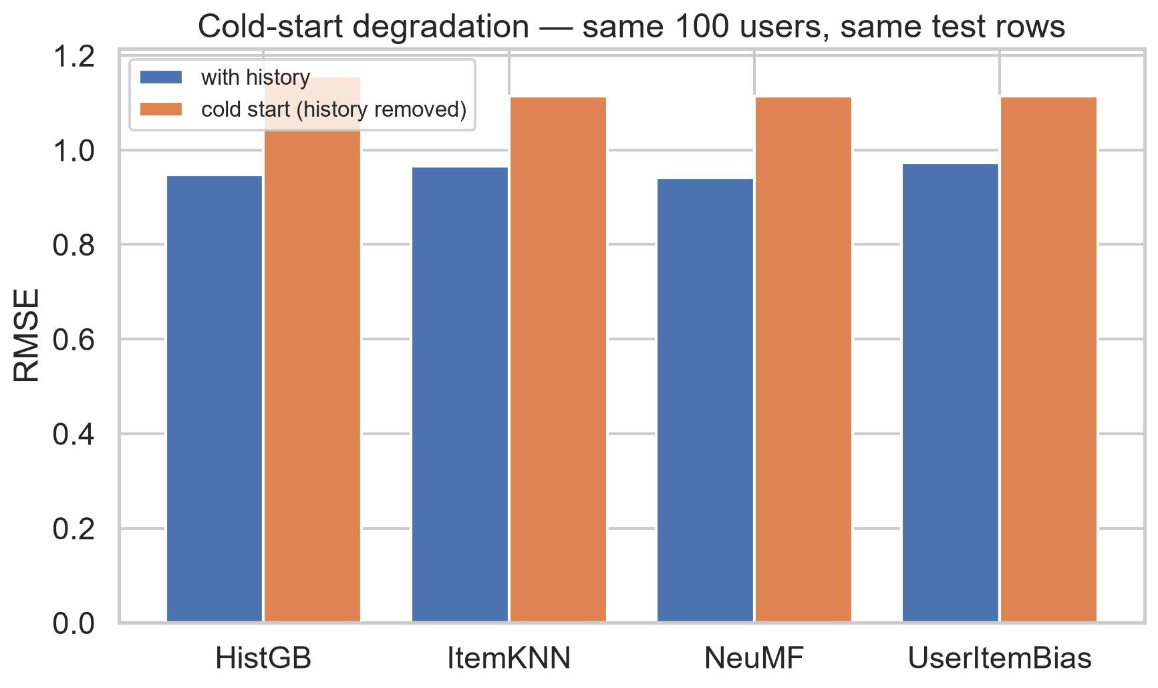
Bias II — Cold Start, Measured Causally
model | with_history | without_history | degradation
HistGB | 0.9467 | 1.1567 | 0.2100
ItemKNN | 0.9654 | 1.1142 | 0.1488
NeuMF | 0.9412 | 1.1142 | 0.1730
UserItemBias | 0.9732 | 1.1142 | 0.1410
Notes:
Same 100 users, same test rows; only difference is whether their history was in training. Every model degrades 0.14–0.21 RMSE. Key insight: with no history, the demographics-bearing model (1.157) is WORSE than a demographic-free popularity prior (1.114) — stereotypes are less accurate than not guessing.

Slide 14
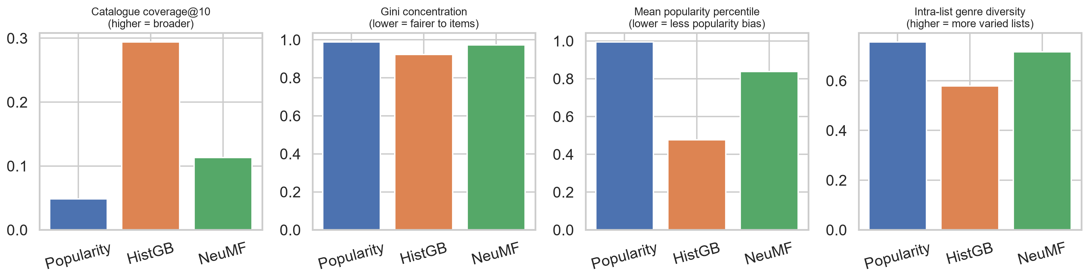
Bias III — Diversity: Accuracy Isn't Everything
model | coverage@10 | gini | mean_pop_percentile | intra_list_diversity | novelty_bits
Popularity | 0.0480 | 0.9880 | 0.9940 | 0.7560 | 7.8310
HistGB | 0.2940 | 0.9220 | 0.4770 | 0.5780 | 12.3150
NeuMF | 0.1130 | 0.9730 | 0.8390 | 0.7160 | 9.4780
Notes:
Full-catalogue top-10 for every user. NeuMF (accuracy winner) is popularity-biased: mean recommended-item popularity percentile 0.84, coverage 11%. HistGB reaches 6x deeper into the catalogue (29% coverage, percentile 0.48) but builds genre-narrower lists (ILD 0.58) — its genre-affinity features are a measurable filter-bubble mechanism. No model dominates: this is the real trade-off slide.

Slide 15
Ethics — Grounded in This Dataset
Privacy — 1997 consent norms; ZIP code dropped (Sweeney 2000); ratings are identifying (Netflix Prize)
Fairness — measured gender gap; ablation: removing demographics costs +0.0029 RMSE, no NDCG loss → drop them
Recommendation bias — top 10% of movies hold 42.7% of ratings; long-tail RMSE penalty measured
Filter bubbles — genre-affinity SHAP + intra-list diversity: the mechanism, quantified
Transparency — SHAP gives faithful per-decision explanations; NeuMF embeddings are post-hoc only
User trust — /explain endpoint, honest cold-start flag, visible feedback → retraining loop
Notes:
Six required themes, each tied to a computed fact: privacy (1997 consent, ZIP dropped as quasi-identifier, Netflix de-anonymisation precedent), fairness (71% male data → measured gender gap), recommendation bias (42.7% concentration), filter bubbles (affinity SHAP + ILD), transparency (SHAP-faithful vs embedding post-hoc), trust (explain endpoint, cold-start honesty). The ablation makes fairness actionable: dropping demographics costs +0.003 RMSE.

Slide 16
Deployment Design
REST API: /recommendations, /predict, /explain (SHAP), /feedback, /health
Serving: Docker + autoscaled CPU containers; Redis cache; model registry (MLflow)
Chosen server: demographics-free HistGB (evidence-based); NeuMF path kept for A/B
Monitoring: latency/errors → online RMSE + CTR → coverage & subgroup deltas
Retraining: weekly + drift-triggered; fairness regression blocks release
Versioning: data hashes, semantic model versions, shadow → 5% canary → full
Notes:
Two-stage: precomputed ItemKNN similarities generate candidates (22 MB, memory-resident), demographics-free HistGB ranks them — sub-millisecond scoring, CPU-only, meets 50ms p99. Monitoring has three layers, and layer 3 is responsible-AI: catalogue coverage and subgroup deltas as first-class production metrics. A retrained model ships only if it does not widen subgroup gaps — fairness as a release gate, not a dashboard.

Slide 17
Conclusions
1. NeuMF is the accuracy winner (RMSE 0.9150) — but by only ~1% over ItemKNN (0.9224)
2. Learning curve still steep at 80K ratings → the deep advantage grows with data; at this scale classical CF is competitive
3. Accuracy, explainability and diversity trade off — no model dominates all three
4. Fair-by-design is cheap: dropping protected attributes costs +0.003 RMSE
Recommendation: serve demographics-free classical ranker with diversity re-ranking; A/B NeuMF as data grows
Limitations: one dataset, 1998 data, offline metrics only · Future: temporal splits, implicit feedback, re-ranking
Notes:
Land the four findings, then the recommendation. Deep won accuracy but not deployment: at 100K-rating scale the gap is ~0.007-0.012 RMSE, while explainability, cold-start behaviour and diversity all favour different designs. The distinction-level point: model choice is a multi-objective decision, and we measured every objective.

